Slide 1
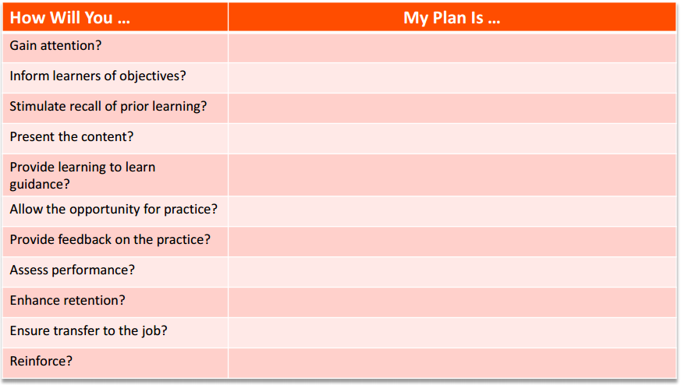
Brain-Aware Design

