Slide 1
Five Steps to Successful
Brain-Based Learning

Slide 2
Please introduce yourself and tell us what you want to learn.
Welcome!

Slide 3
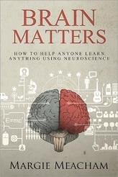
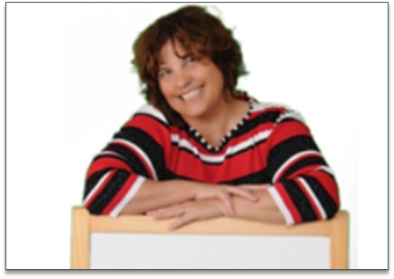
Margie Meacham
Chief Freedom Officer, learningtogo.info
Margie Meacham is an adult learning expert with a master of science in Learning Technologies and more than 15 years of experience in the field. A self-described “scholar-practitioner,” Margie collaborates with like-minded instructional designers to find practical applications of neuroscience to instructional design. You can follow Margie on LinkedIn, Facebook, and Twitter or visit her website at www.learningtogo.info.
Margie Meacham, “The Brain Lady”
Chief Freedom Officer, Learningtogo.info
Introducing Your Instructor

Slide 4
Statement | True or False
Brains work like super-computers.
Listening to Mozart can make you smarter.
Most people only use about 10% of their brains.
The more wrinkles you have in your brain, the smarter you are.
You can learn while you sleep by playing an audio book.
Adults learn differently than children.
Intelligence is an inherited trait.
Left-brained people are analytical and right-brained people are creative.
We should deliver learning that is compatible with each person’s learning style.
The brain stops growing and starts to decline when we reach adulthood.
Some people are naturally better learners than others.
How Much do you Know?

Slide 5
Statement | True or False
Brains work like super-computers. | F
Listening to Mozart can make you smarter. | F
Most people only use about 10% of their brains. | F
The more wrinkles you have in your brain, the smarter you are. | F
You can learn while you sleep by playing an audio book. | F
Adults learn differently than children. | F
Intelligence is an inherited trait. | F
Left-brained people are analytical and right-brained people are creative. | F
We should deliver learning that is compatible with each person’s learning style. | F
The brain stops growing and starts to decline when we reach adulthood. | F
Some people are naturally better learners than others. | F
Answers

Slide 6
Learning Objectives
In this webinar, you will learn how to:
Separate fact from hype when you read about neuroscience in the popular press
Write learning objectives that stimulate existing neural pathways and make the brain ready to learn new skills
Tap into learners’ unconscious wiring to grab and maintain attention
Implement simple brain-based learning techniques into your existing programs to enhance learning and performance
Learning Objectives

Slide 7
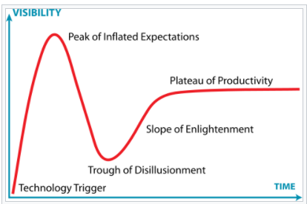
The Hype Cycle

Slide 8
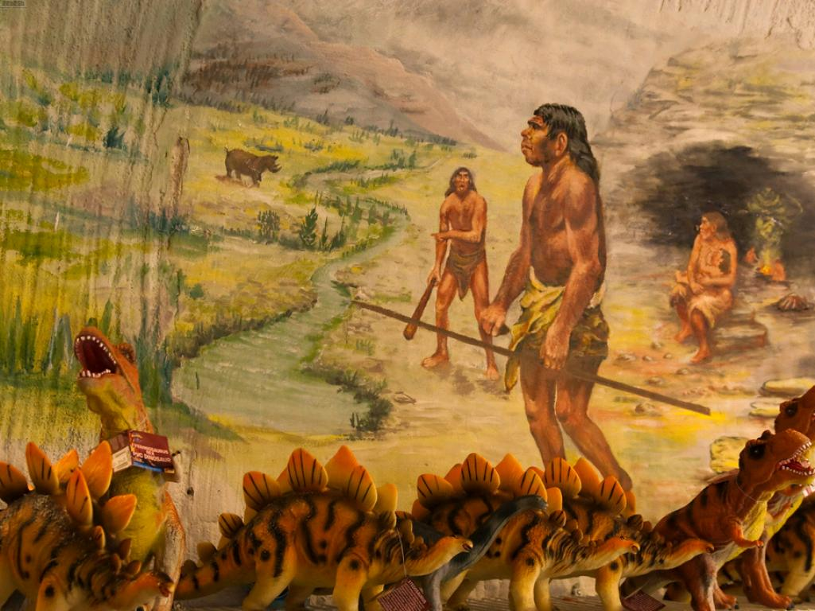
A Brief History of Learning

Slide 9
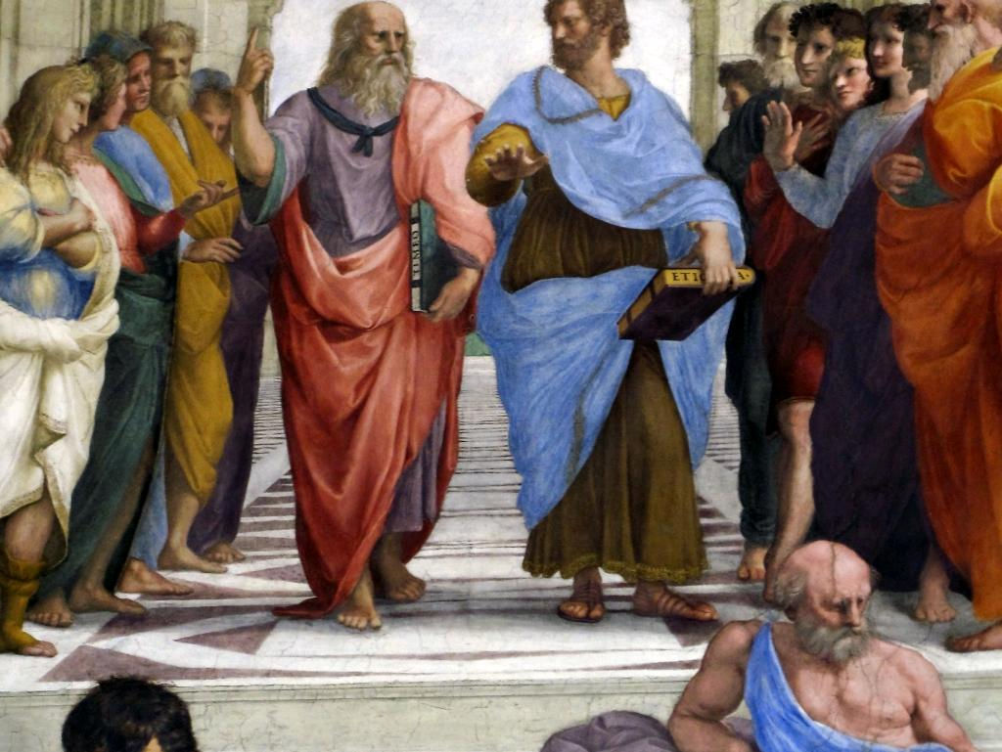
The Socratic Method

Slide 10
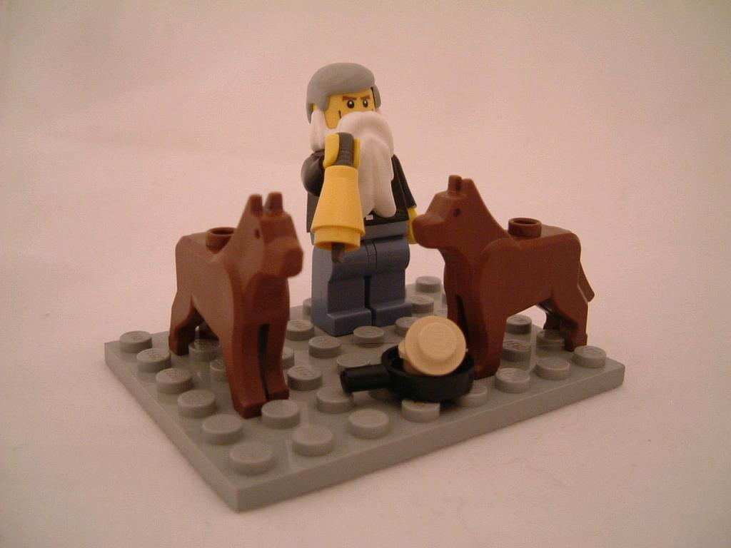
Conditioning Theory

Slide 11
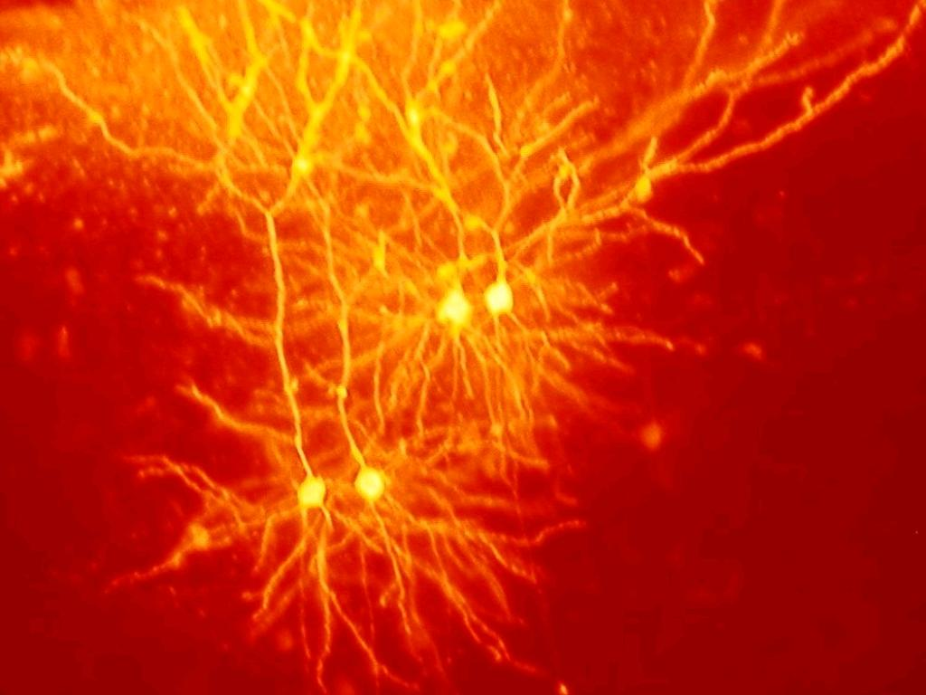
Cognitive and Educational Psychology
Biology
Biochemistry
Neurology
Quantum Physics
Computer Science and Artificial Intelligence
The Neurosciences

Slide 12
Your brain is hard-wired to keep you alive!
Survival

Slide 13
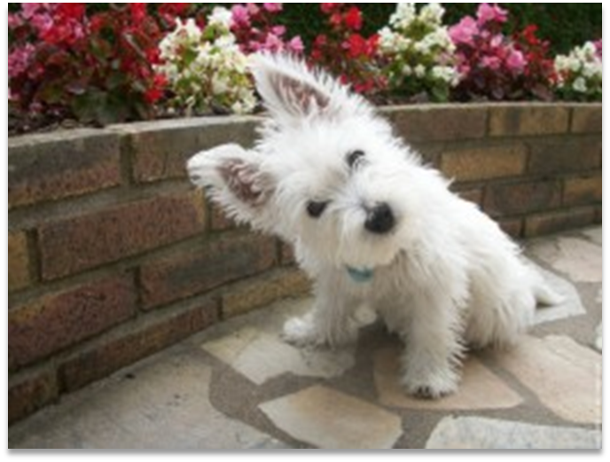
Our attention span is three seconds!
Attention

Slide 14
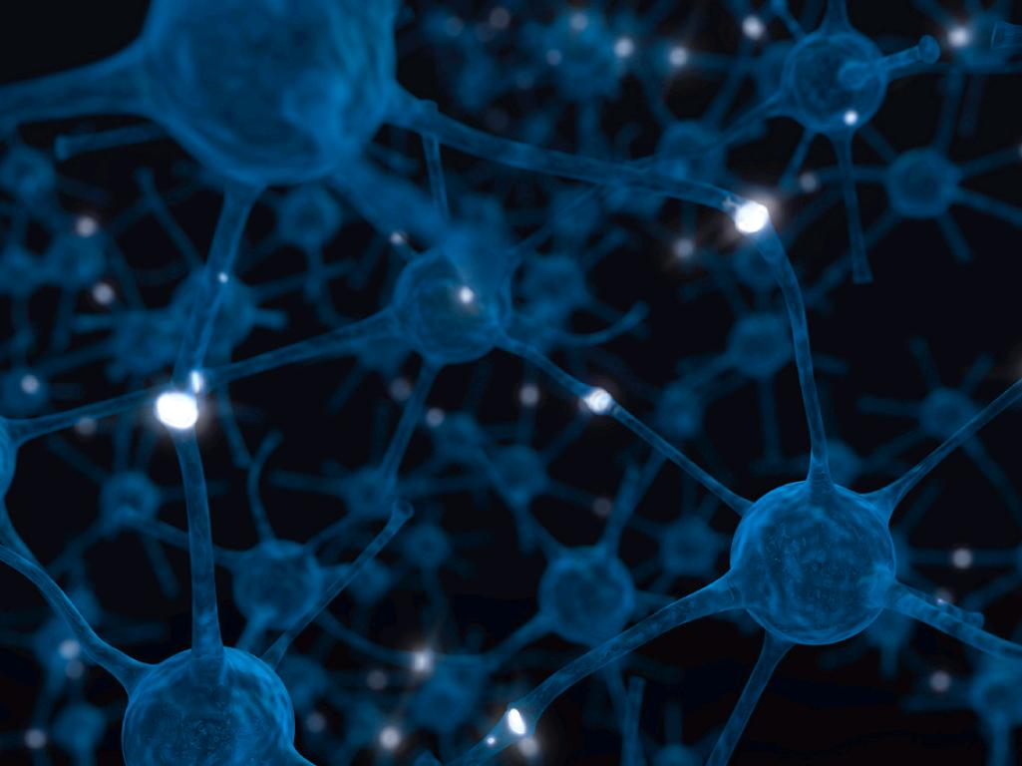
Your brain is constantly rewiring itself!
Neuroplasticity

Slide 15
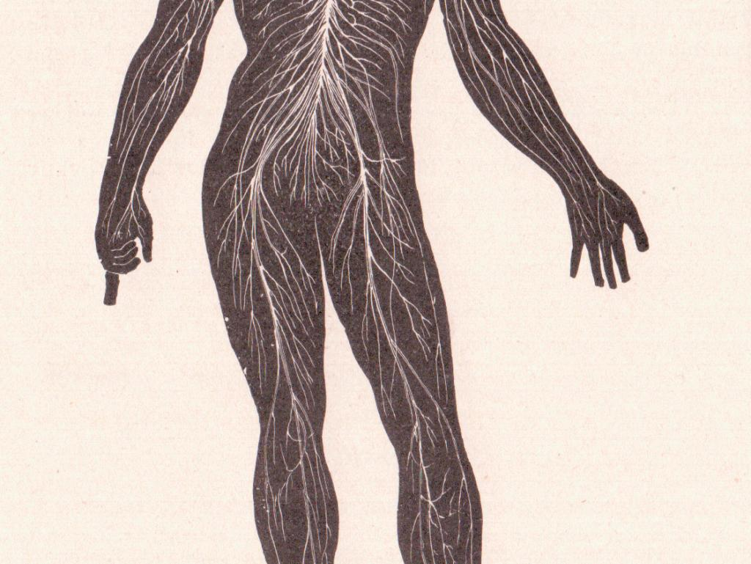
Your brain is everywhere!
Mind/Body Continuum

Slide 16
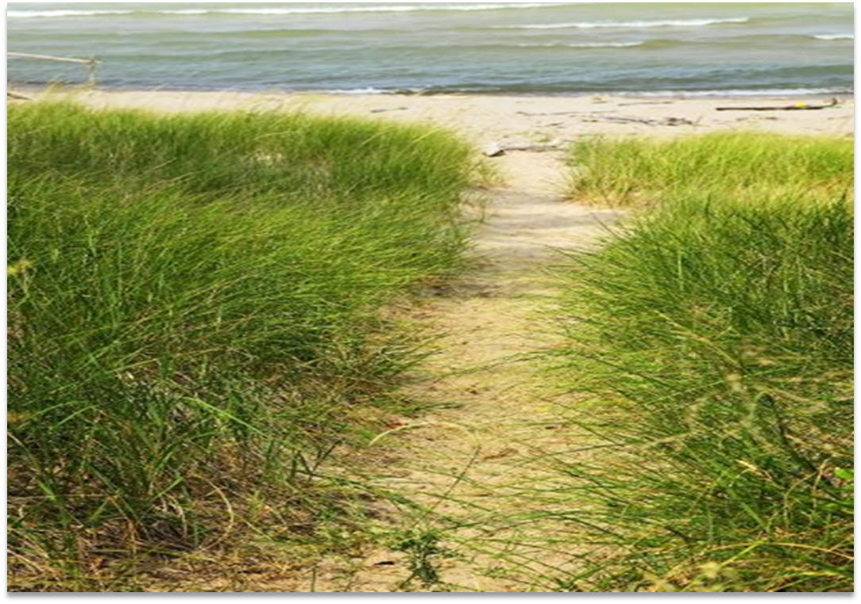
“Neurons that wire together fire together.”
Repetition

Slide 17
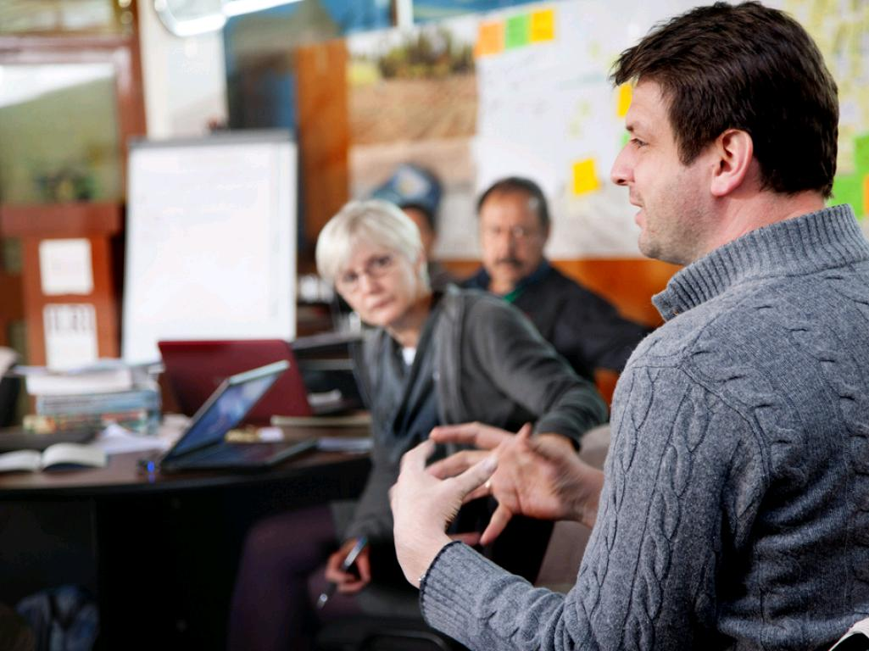
We learn better with others!
Social Learning

Slide 18
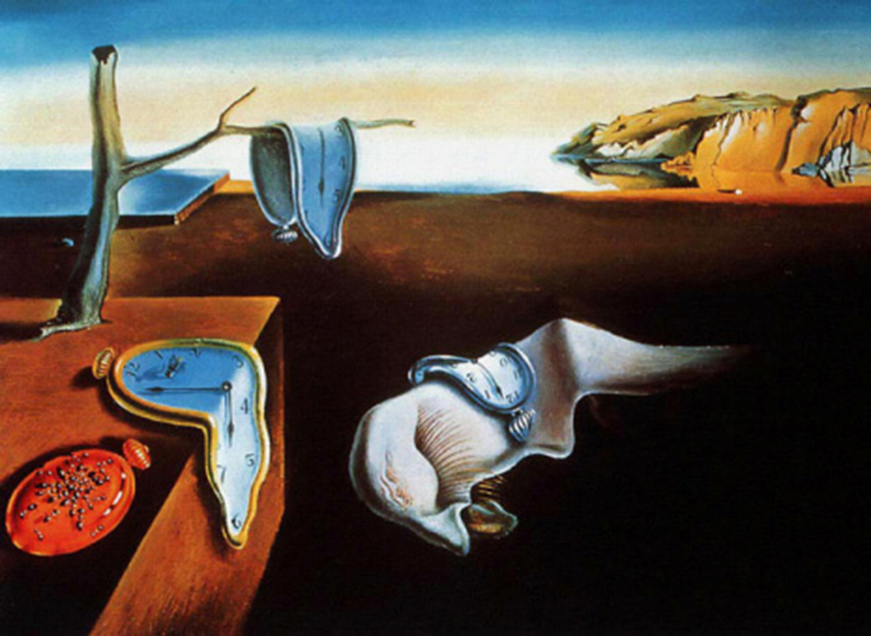
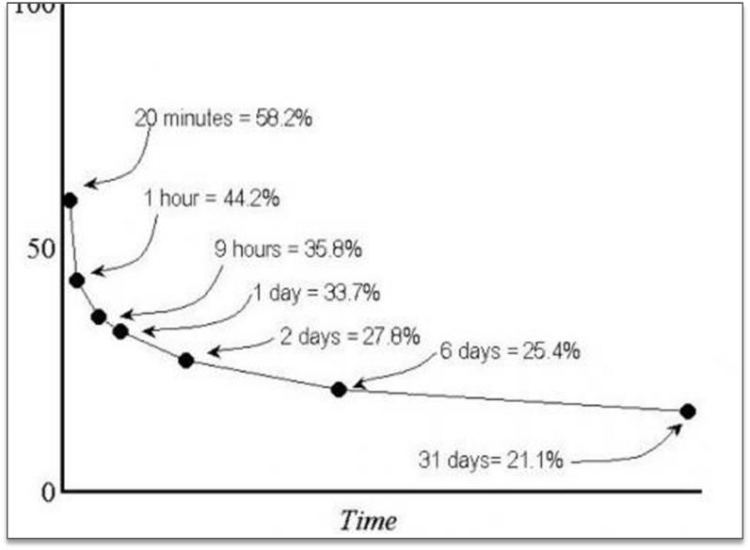
Learning needs frequent reinforcement!
The Ebbinghaus Forgetting Curve

Slide 19
We need time to reflect on what we have learned!
Reflection

Slide 20
Your brain links new information to past learning experiences!
Link to Prior Learning

Slide 21
Your brain predicts the future based on past experiences.
Predicting Future Outcomes

Slide 22
The Physical act of writing notes by hand creates additional pathways to the same information!
Taking Notes Matters

Slide 23
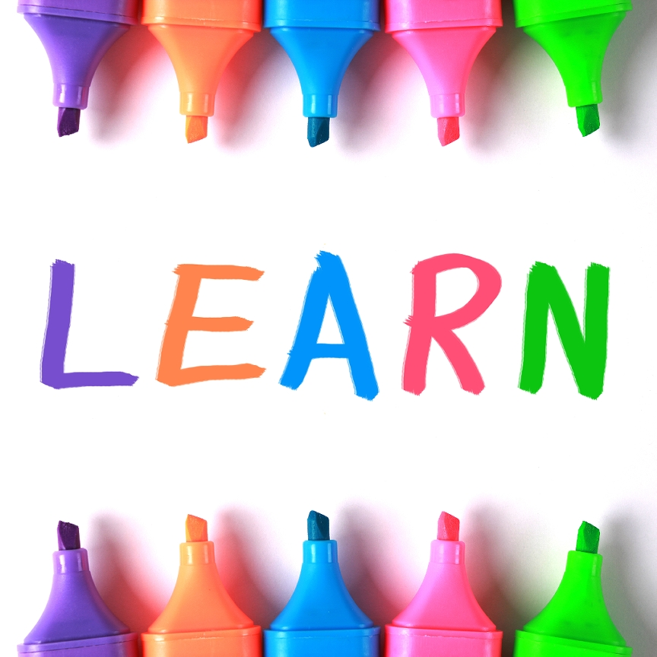
“Learning to learn” activities increase overall retention and retrieval.
Your Brain Must Learn How to Learn

Slide 24
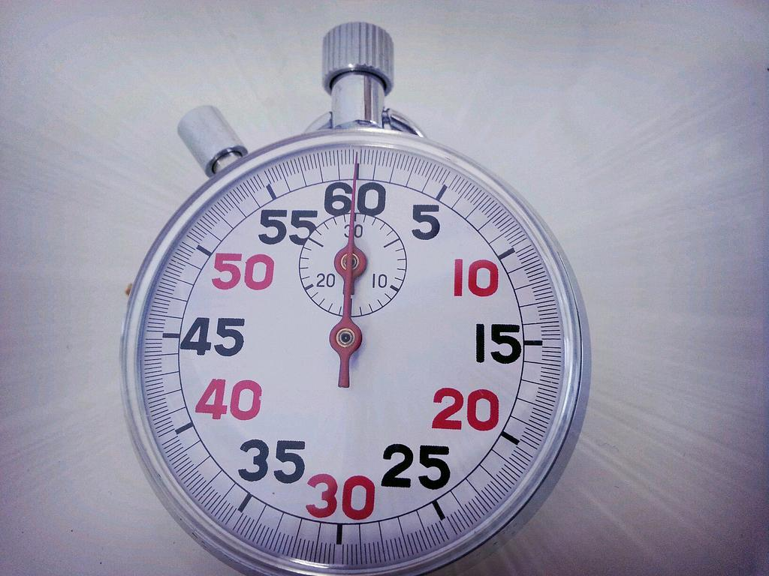
What did you learn about how the brain learns?
Sixty Seconds!

Slide 25
Survival
Attention
Neuroplasticity
Mind/Body Continuum
Repetition
Social Learning
Reflection
Link to Past Learning
Predicting Future Outcomes
Taking Notes Matters
“Learning to Learn” Works
How many did you remember?

Slide 26
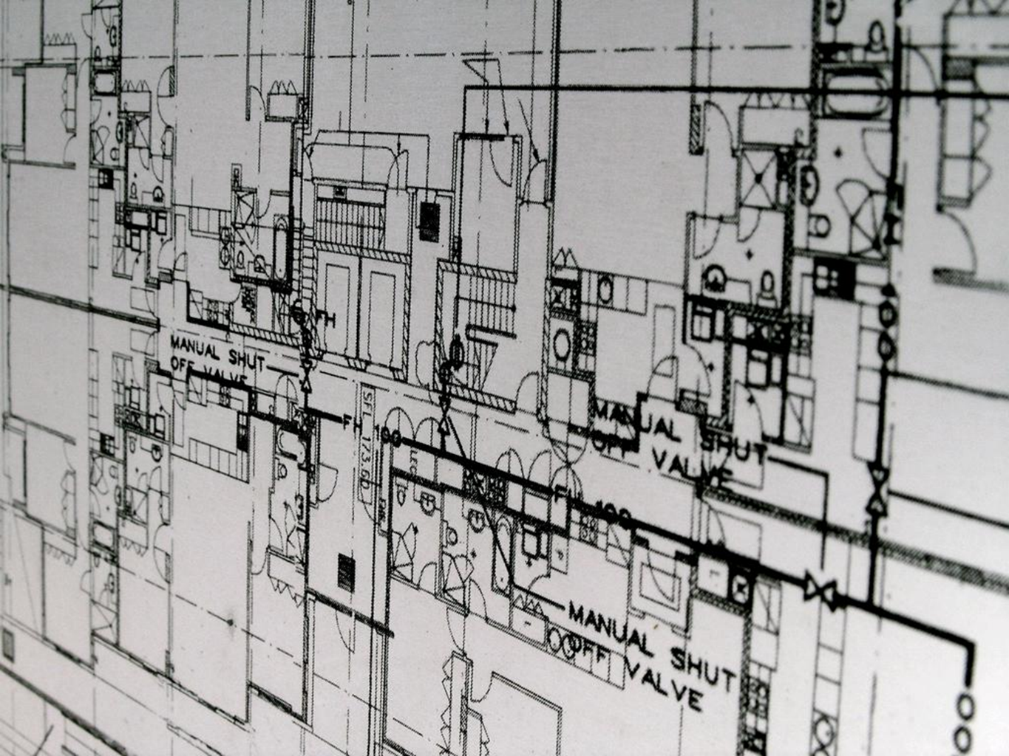
Wouldn’t it be nice to have a blueprint?

Slide 27
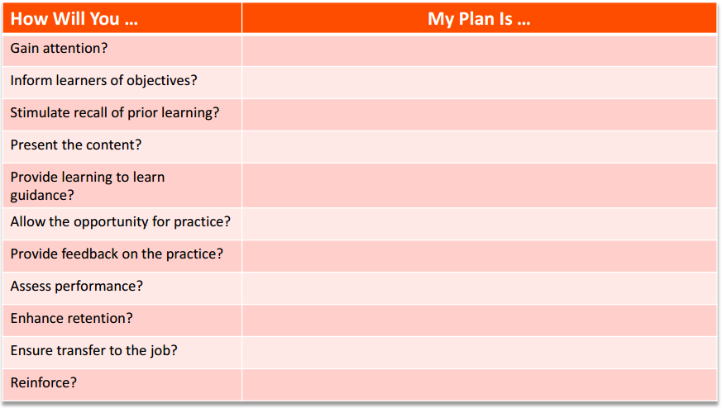
Brain-Aware Design

Slide 28
Gain attention
Set goals/objectives
Link to prior learning
Present new content
Teach learning to learn (“guidance”)
Provide feedback
Assess performance
Enhance retention and transfer
Robert Gagne’s Nine Events of Learning

Slide 29
Write learning objectives that stimulate existing neural pathways and make the brain ready to learn new skills | Link to prior learning Predict future outcomes Tell an incomplete story or present a puzzle to solve
Tap into learners’ unconscious wiring to grab and maintain attention | Appeal to survival Use the entire brain/body Make it social
Implement simple brain-based learning techniques into your existing programs to enhance learning and performance | Use the Brain-Based Learning Template Repeat, repeat, repeat, repeat, repeat, repeat, repeat, repeat
Separate fact from hype when you read about neuroscience in the popular press | Keep learning! Use your ATD membership resources.
Learning Objectives

Slide 30
What did you already know? | What were you wrong about? | What did you learn?
Reflection

Slide 31
Brain Based Learning Resources
www.learningtogo.info
ATD Science of Learning blog: http://tinyurl.com/o53qlym
Growth Mindset: http://mindsetonline.com/
The Power of Believing (TED Talk): http://www.ted.com/talks/carol_dweck_the_power_of_believing_that_you_can_improve?language=en
A look inside the brain in real-time (TED Talk): http://www.ted.com/talks/carol_dweck_the_power_of_believing_that_you_can_improve?language=en
A Light Switch for Neurons (TED Talk): http://www.ted.com/talks/ed_boyden
The Future of the Brain: Essays by the World's Leading Neuroscientists, by Gary Marcus (Editor), Jeremy Freeman (Editor).
Incognito: The Secret Lives of the Brain, by David Eagleman.
The Dragons of Eden: Speculations on the Evolution of Human Intelligence, by Carl Sagan.
Brain Matters: How to help anyone learn anything using neuroscience, by Margie Meacham
How driving a taxi changes London cab drivers’ brains: http://www.wired.com/2011/12/london-taxi-driver-memory/
Navigators from the planet Hippocampus: https://freestatestudio.wordpress.com/tag/london-cabbies/
Is Google Making Us Stupid? By Nicholas Carr
Visible Learning and the Science of How We Learn by John Hattie and Gregory C. R. Yates
Why Man Creates: https://www.youtube.com/watch?v=euh0kEU20V4
On Digital Pedagogy: https://nginguthembi.wordpress.com/2014/03/12/on-digital-pedagogy/
The Importance of Taking Notes by Richard Branson: https://www.linkedin.com/pulse/importance-taking-notes-richard-branson
The Pen is Mightier than the Keyboard: http://pss.sagepub.com/content/25/6/1159
The Gartner Hype Cycle: https://en.wikipedia.org/wiki/Hype_cycle

Slide 32
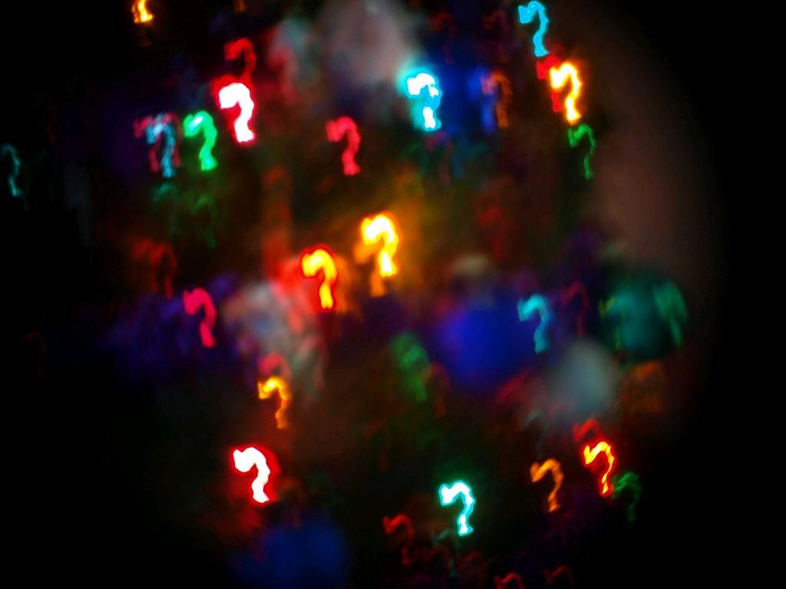
Questions?

Slide 33
Reminders

Slide 34
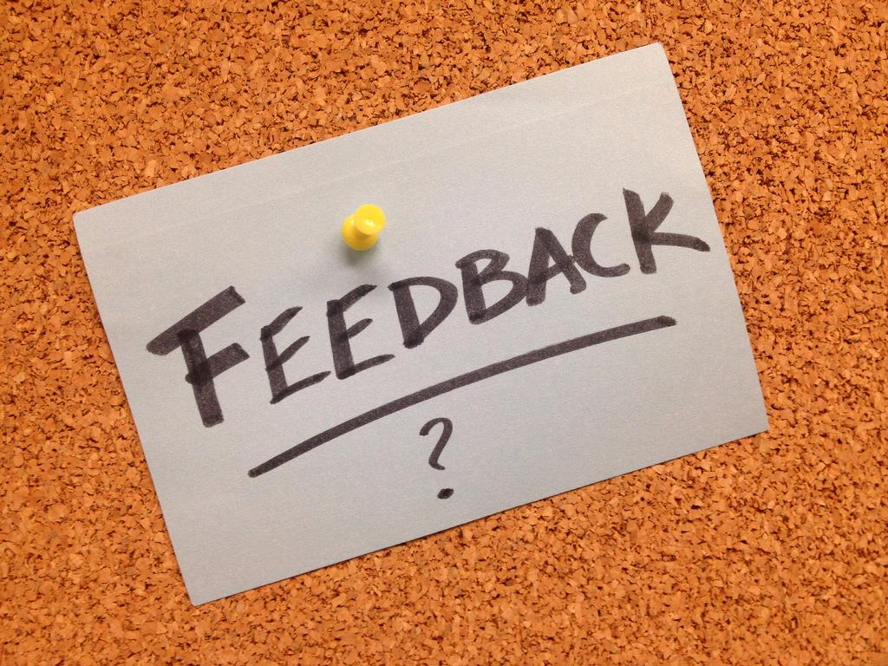
How will you use this info?

Slide 35
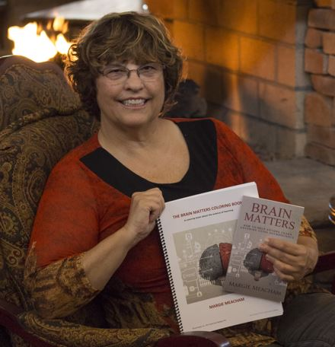
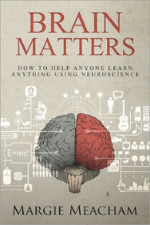
Want an advance copy of Brain Matters Too? Write me at Margie@learningtogo.info
Also available on Amazon.com
Book Drawing

Slide 36
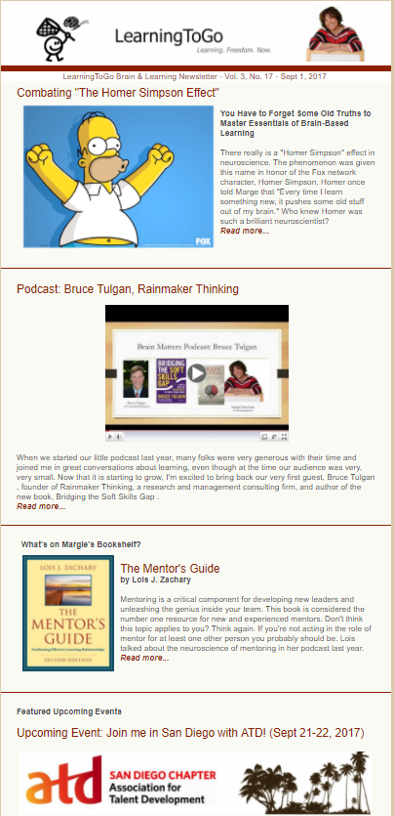
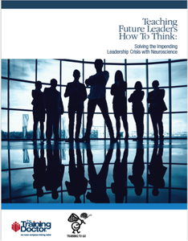
Join our learning community
Free ebook and newsletter
http://learningbinge.com/
@margiemeacham
Margie Meacham
Margie Meacham
Margie@learningtogo.info
https://learningtogo.info/a-free-ebook-from-learningtogo-and-the-trainingdoctor/
Let’s Connect!
30

Slide 37
