Slide 1
Extending Learning Through Technology
Facilitated by Jeanne Strayer

Slide 2
If your goal is to produce long-term retention, and if your goal is to produce behavior change, then what you do after training is more important than what you do during training.
-- Art Kohn Professor, Cognitive Science Portland State University

Slide 3
The Forgetting Curve
Memory Retention %
1
2
3
4
5
6
7
8
Days After Training
Notes:
Research on the forgetting curve (Figure 1) shows that within one hour, people will have forgotten an average of 50 percent of the information you presented. Within 24 hours, they have forgotten an average of 70 percent of new information, and within a week, forgetting claims an average of 90 percent of it.

Slide 4
Forgetting is Good!
Your brain needs to forget things that are no longer useful. And this forgetting is inevitable, useful, and adaptive because it clears your memory for things that are more relevant.
The problem is that in this memory purging, our brain often forgets important information.
Notes:
Example? Phone numbers, Why do we forget 90 percent of what we learn within one week? From the perspective of a neuroscientist, this question speaks to a fundamental misunderstanding about the brain and about forgetting.
Forgetting is not a failure at all. Instead forgetting is a natural, adaptive, and even desirable activity.
At every moment sensory information is flooding your brain, and your brain actively suppresses most of it This suppression is highly adaptive because, by suppressing most information, you are now free to focus on what you think are the one or two more essential pieces of information.

Slide 5
Overcoming the Forgetting Curve
Although the brain will inevitably purge most of what it learns, it does retain some information.
Contemporary neuroscience has discovered the signals that teach your brain which signals to purge and which information to retain.

Slide 6
Technique: Recall
It is possible to signal the brain that a particular piece of information is important and that it should retain it.
When a learner is forced to recall information in the hours and days after training, then they are much, much more likely to retain that information in the long run.
Professor Henry Roediger, Professor Washington University St. Louis

Slide 7
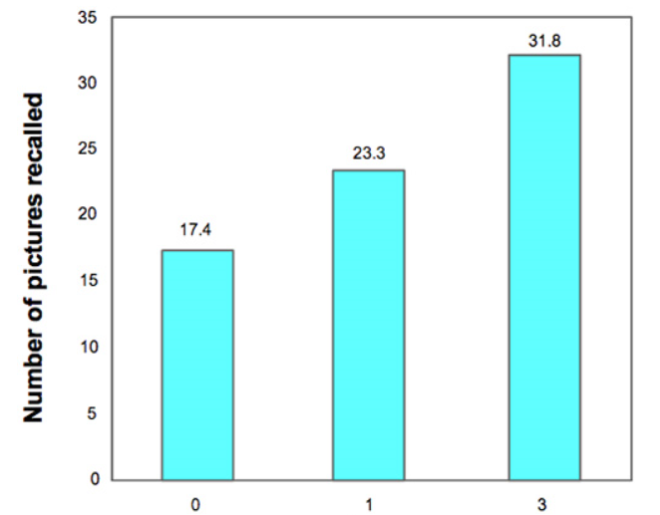
Recall Experiment
0 = No recall
1 = Once practice at recall
3 = Three practices at recall
Notes:
In the first, study, students studied a series of pictures and were told to remember as many of them as possible. Afterward, they let one group leave the lab while they gave a second group a brief booster quiz during which they simply wrote down as many pictures as they could recall; they gave a third group three successive opportunities to recall the pictures.
Note that they did not give these latter two groups any additional study time—they simply asked them to recall the photos.

Slide 8
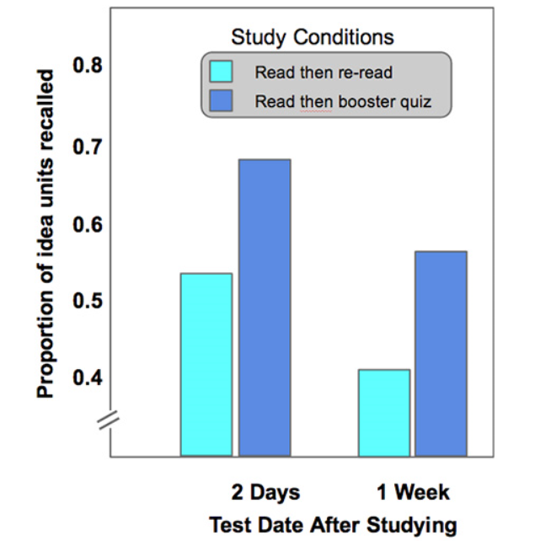
Technique: Boosters
Notes:
Dr. Roediger conducted another experiment where a group of students read essays on science topics. Afterward, half of the students had a chance to reread the text and half of the students spent about the same amount of time answering a series of booster questions that asked them to recall material from the passages.
Several days later, the researchers gave all of the students an exam over the materials. The results showed that those students who read the material and took a booster quiz did significantly better than those students who read and then reread the material. This was true when they conducted the exam two days after studying and even truer when they did the exam one week after studying (see Figure 3).

Slide 9
Resetting the Learning Curve
Your brain wants to retain useful information and purge what is not.
If you recall that information in the hours and days after training, your brain tags that information as important and is more likely to retain it.
If you use it, you won’t lose it!

Slide 10
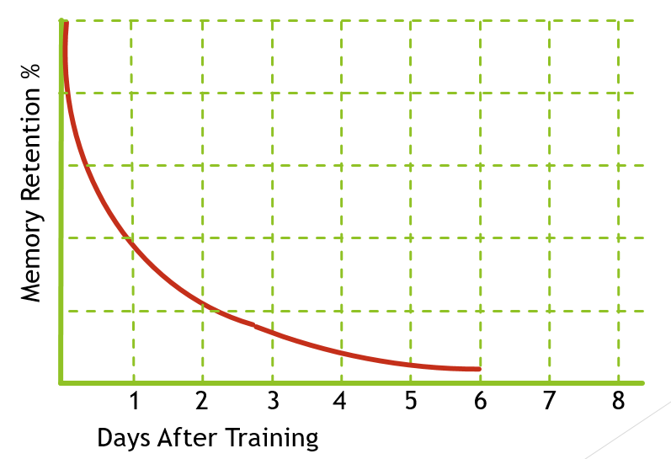
Boosters
Providing learnerswith booster events after training can reshape their forgetting curve
Notes:
For example, if you provide employees with a leadership seminar on Monday, you can expect that most of this information will be lost within a week. However, if you provide a booster event, such as a multiple-choice questionnaire, it causes the learner to recall the information, which will reset the learner’s forgetting curve (see Figure 4). Furthermore, strategically providing a series of these booster events will reset the forgetting curve each time and will maximize long-term retrieval (Figure 5).

Slide 11
Boosters
Providing learners with booster events after training can reshape their forgetting curve
Notes:
For example, if you provide employees with a leadership seminar on Monday, you can expect that most of this information will be lost within a week. However, if you provide a booster event, such as a multiple-choice questionnaire, it causes the learner to recall the information, which will reset the learner’s forgetting curve (see Figure 4). Furthermore, strategically providing a series of these booster events will reset the forgetting curve each time and will maximize long-term retrieval (Figure 5).

Slide 12
The Halo Effect
These booster events improve retention for the entire learning experience, not just for the particular topics in the quiz question.
This “halo effect” means that just a few booster experiences can enhance the retention of the entire training session.

Slide 13
Adding Technology: Booster Examples
After a Conference Session on Brain Science with Art Kohn:
Booster 1
Booster 2

Slide 14
Adding Technology: Booster Examples
Booster 3
Booster 4
Booster 5
Notes:
http://www.performancexpress.org/2013/08/multiple-choice-tests-doomed-or-redeemed/?goback=%2Egde_27402_member_267310030#%21

Slide 15
Multiple-Choice Redeemed
An experimental study published at Psychological Science
Cued Recall vs. Multiple Choice
The multiple-choice test improved later recall of the tested information more than the cued-recall test did.
Those that took the multiple choice test initially performed slight higher on related items on the final test than the control group
Well-designed multiple-choice tests not only they promote learning of information, they can also facilitate learning of content related to incorrect alternatives (by forcing learners to think why the alternatives are incorrect answers).
In that regard, multiple-choice testing has a superior advantage compared to cued-recall testing, which forces learners to figure out the correct answer only.
Multiple Choice Redeemed http://www.performancexpress.org/2013/08/multiple-choice-tests-doomed-or-redeemed/?goback=%2Egde_27402_member_267310030#%21

Slide 16
Booster Technology Companies

Slide 17
Other Technologies for Extending Learning
Social Tools
Social tools offer excellent means of staying connected with learners and getting into the spaces before, between, and after formal instruction or other events.
Jane Bozarth, PHd, Elearning Coordinator for North Carolina

Slide 18
Social Tools Examples
BEFORE
Pinterest Board illustrating how to get to the training center
DURING
Microblogging tool for managers-in-training to use for a leadership book-club discussion
Online Community to support customer service reps by giving them a place to share war stories and strategies for dealing with challenges
AFTER
Online post-course community for learners to share experiences and get additional support and encouragement as they work to implement their new learning
A Wiki for those in a program to work together to edit a FAQs page for use by the next group coming to the program
Closed Facebook Group?
LinkedIn group?
Other?

Slide 19
Your Stories…
Jeanne Strayer
Strayer Instructional Design
Carlsbad, CA
760-632-8655

